Slide 1
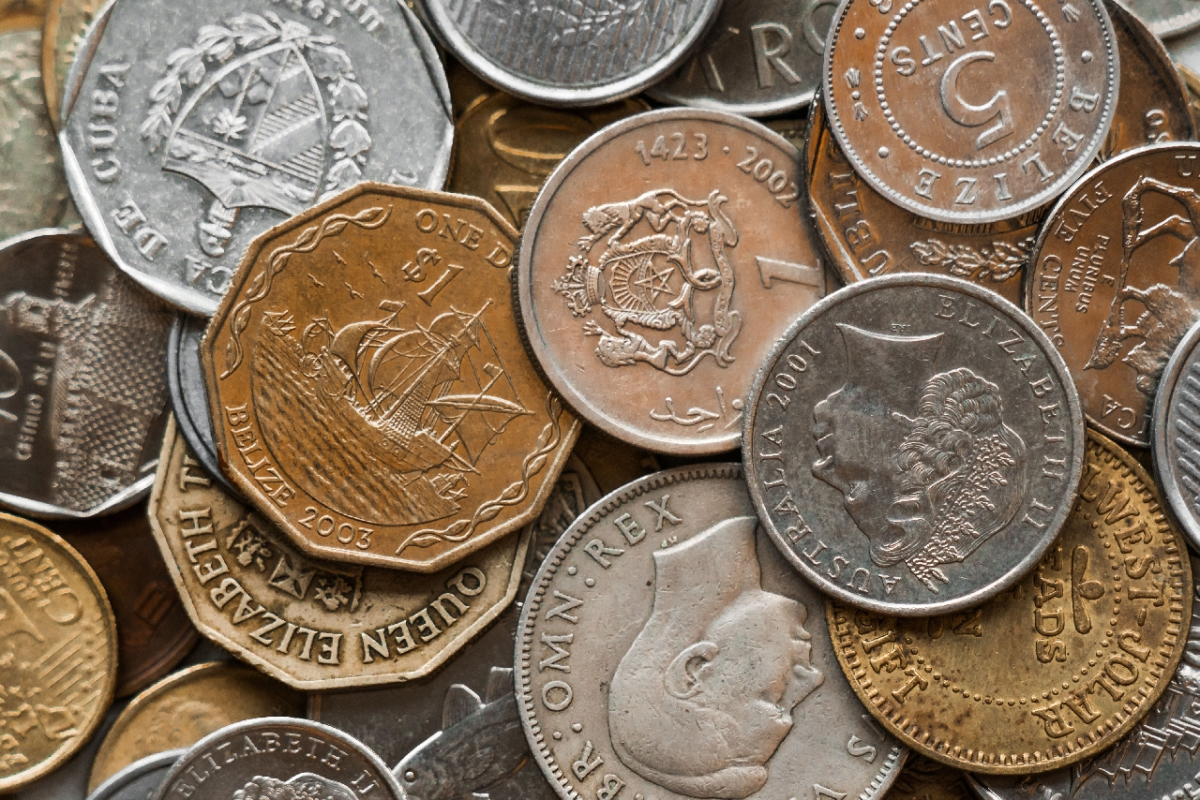

A Level Business
Improving cash flow and profits
profit margin
sale and leaseback
business efficiency
debt factoring
reduce borrowing costs
improve capacity
Improve methods
of production
improve credit terms

Slide 2
A Level Business: Improving cash flow and profits
£ € $
Cash flow
Cash flow is the movement of money in and out of a business
Definitions
Profits
Profit is measured as total revenue minus all costs and taxation
Profits and cashflow
Direct link between low profits (or losses) and cashflow problems
Understand the:
. reasons for cash flow problems
. methods used to improve the cash flow in a business
. methods used to improve a business’s profits and profitability
. challenges faced by businesses in improving their cash flow and profit

Slide 3
A Level Business: Improving cash flow and profits
Define the following terms
 | Term | Definition
1 | Overtrading
2 | Seasonal variation
3 | Trade credit
4 | Debt factoring
5 | Sales and leaseback
6 | Production capacity
7 | Variance analysis
8 | Working cpaital
Definitions

Slide 4
A Level Business: Improving cash flow and profits
Customers pay for
the products
Stock (products)
ordered from supplier
£ cash inflow
from customers
£ cash outflow to suppliers
Improving cash flow
Cashflow cycle
Stock (products)
sold
Production
of goods
Stock held
until needed
Understand the methods used to improve the cash flow in a business

Slide 5
A Level Business: Improving cash flow and profits
Assess the problems that can present themselves for a business in the cashflow cycle
Improving cash flow
Understand the methods used to improve the cash flow in a business

Slide 6
A Level Business: Improving cash flow and profits
Inaccurate cashflow
forecasting
Lack of credit control
Too much stock
Improving cash flow
Causes of cash flow problems
Seasonal variation
Too much trade credit
Overtrading
Understand the methods used to improve the cash flow in a business

Slide 7




A Level Business: Improving cash flow and profits
Inaccurate cashflow forecasting
. Predicting cashflow can be difficult but it is important to be as accurate as possible to avoid cashflow problems
. Unexpected costs or payment delays can create cashflow issues e.g. fuel price rises
Lack of credit control
. Making sure payments are paid on time is crucial
. Avoiding no payment (bad debt) or cashflow problems will occur
Causes of cash flow problems
Too much trade credit
. Giving credit is a way of attracting business
. Most businesses allow customers 28 – 90 days to pay thus payments are delayed
. If payments are move towards 90 days or are delayed beyond this can cause problems
Understand the methods used to improve the cash flow in a business

Slide 8

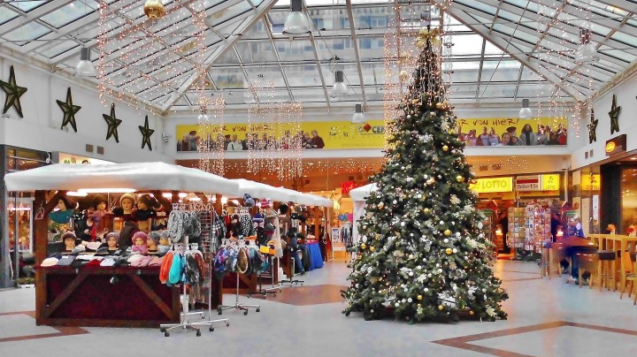
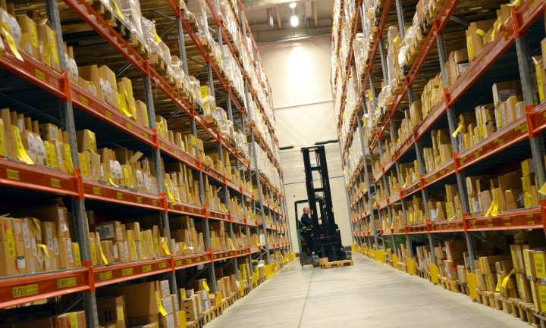
A Level Business: Improving cash flow and profits
Seasonal variation
. Many businesses have seasonal trade which affect cashflow e.g. Christmas and summer high revenue, other times less so – but costs remain constant
Too much stock
. Bulk buying to reduce purchase price BUT
. Stock ties up cash
. Stock can go out of date and be worth less
Causes of cash flow problems
Overtrading
. Growth of a business can cause problems as money is spent on expansion e.g. rent / new equipment / labour – before extra revenue is generated
Understand the methods used to improve the cash flow in a business

Slide 9
A Level Business: Improving cash flow and profits
Importance of monitoring cash flow
Forecast v Actual cashflow
Improving cash flow
. Compare actual with forecast = variance analysis
. Investigate possible reasons for difference and actions to be taken
Unexpected issues
Spotting trends
Self correcting
. Cancelled order
. Unexpected order
. Non payment (company gone bankrupt)
. Pandemic (COVID)
. A trend in sales – up or down e.g. new competitor
. A temporary gain or slump which will return to normal
Understand the methods used to improve the cash flow in a business

Slide 10
A Level Business: Improving cash flow and profits
Improved control of working capital
Debt factoring
Sale and leaseback
Methods of improving cash flow
Improving cash flow
Arrange short-term borrowing
Offer less
trade credit
Negotiate improved terms of trade
Understand the methods used to improve the cash flow in a business

Slide 11
A Level Business: Improving cash flow and profits
Improved control of working capital
Debt factoring
Sale and leaseback
. Working capital is the money a business needs on a day to day basis to pay wages, fuel, etc
. Businesses need to ensure they have enough working capital at any given time
. Invoices can be ‘sold’ to banks or others who will pay cash for them
. 80% is paid immediately, then 15% when the. invoice is paid with the bank keeping 5%
. Increasingly popular method of raising cash
. Asset is sold (a building) then leased back – this gives the business cash but has the commitment of paying the lease each year.
Methods of improving cash flow
Arrange short-term borrowing
Offer less
trade credit
Negotiate improved terms of trade
. Overdrafts allow for short term borrowing but can be expensive
. Short term loans (1-2 years) are cheaper than overdrafts
. Reducing the credit length from 90 to 30 days can improve cashflow
. Some customers may prefer longer credit terms
. Credit terms can delay payment which helps cashflow
. Get a good payment reputation to improve your credit terms from 30 to 60 to 90 days
. Can be difficult for new businesses to get good credit terms to start with
Understand the methods used to improve the cash flow in a business

Slide 12
A Level Business: Improving cash flow and profits
State two advantages of using an overdraft to improve cash flow
State one consequence of reducing customers credit terms
Methods of improving cash flow
State two advantages of spotting trends for a business
Understand the methods used to improve the cash flow in a business

Slide 13
A Level Business: Improving cash flow and profits
Analyse why a sale and leaseback of a business premises might be an attractive option to a business with cash flow problems
Methods of improving cash flow
Understand the methods used to improve the cash flow in a business

Slide 14
A Level Business: Improving cash flow and profits
Analyse why debt factoring might be an attractive option to a business with cash flow problems
Methods of improving cash flow
Understand the methods used to improve the cash flow in a business

Slide 15
A Level Business: Improving cash flow and profits
. A business with a good financial reputation is likely to be able to improve its cashflow and business performance more easily
Business reputation
Banks
Public relations
Suppliers
Improving cash flow
. A business with a good financial history and credit score – without having to use an overdraft – can likely access loans with a lower interest rate, thus reduce costs
. A company with a good financial reputation is likely to improve the chances of securing better ‘financial details’
. Adverse financial reputation likely to mean others will have less confidence in the company therefore more difficult to secure favourable financial terms
. All suppliers want prompt payment in full
. Discounts can be negotiated for prompt payment – reducing cots
. Having a good reputation with suppliers is the key to negotiating favourable terms
Understand the methods used to improve the cash flow in a business

Slide 16
A Level Business: Improving cash flow and profits
Read the statement then decide if it is TRUE or FALSE
 | Statement | T | F
1 | Debt factoring can reduce profit margins
2 | Reducing credit terms has no negative effects
3 | An overdraft is one of the most convenient short term ways to borrow money
4 | Prompt payment is a good start in negotiating for discount from suppliers
5 | Seasonal variation has a positive effect on the cashflow of a business
6 | Buying in bulk in advance is always a good thing for a business’s cash flow
7 | Start-ups can face difficulties securing long credit terms
8 | Sale and leaseback is an increasingly popular form of raising finance
9 | Seasonal variation can create working capital problems
10 | A short term loan may be cheaper than a large overdraft
Methods of improving cash flow
Understand the methods used to improve the cash flow in a business

Slide 17
A Level Business: Improving cash flow and profits
Improve efficiency
Maximise capacity
Reduce sub standard products
Increase prices
Improving profits
and profitability
Improving profits and profitability
Reduce the cost of production
Reduce unprofitable aspects of the business
Improve methods of production
Understand the methods used to improve a business’s profits and profitability

Slide 18
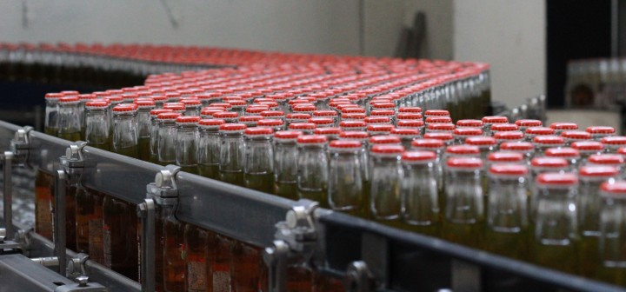

A Level Business: Improving cash flow and profits
£ € $
Improve efficiency
Reduce sub standard products
. There are many ways to improve efficiency in a business
. Aim is to produce goods or service with minimum resources
. Employee efficiency can be key
. Quality control in production can reduce the number of sub standard goods
. Each good rejected has cost implications
. Less rejected goods = increase profitability
Improving profits and profitability
Increase prices
. Increasing prices will improve cashflow and profits
. BUT higher prices can lead your customers to look elsewhere
Maximise capacity
. Maximising capacity improves cash flow and profitability
. Unit cost price is reduced, therefore profits can rise
Understand the methods used to improve the cash flow in a business

Slide 19
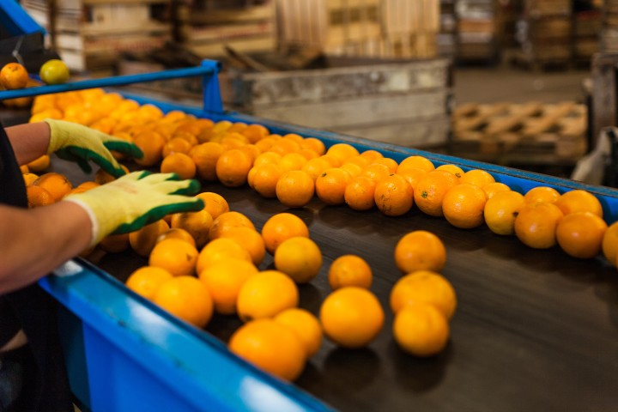
A Level Business: Improving cash flow and profits
Improve methods of production
. There are many ways to improve efficiency in a business
. Aim is to produce goods or service with minimum resources
. Employee efficiency can be key
Reduce cost of production
. Often the first thing to assess is the cost of production
. Maintaining the same quality whilst reducing costs is the challenge for businesses
. Poorer quality goods can lead to a loss of customers
Improving profits and profitability
Reduce unprofitable aspects of the business
. Many businesses particularly larger ones will have aspects of its operation that is less profitability or loss making
. Eliminating these will improve cashflow and profits
Understand the methods used to improve the cash flow in a business

Slide 20
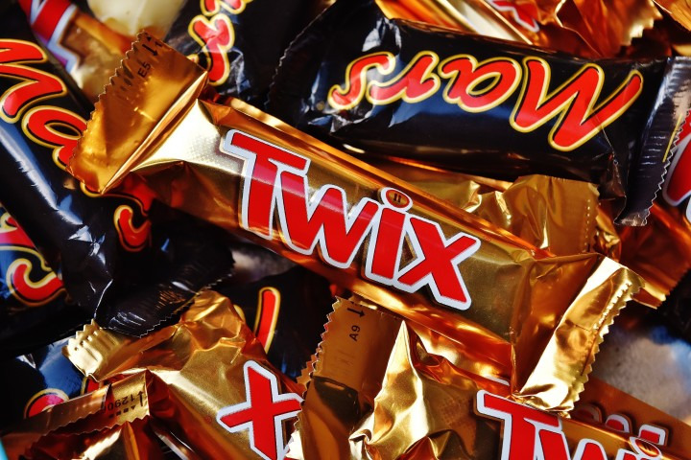
A Level Business: Improving cash flow and profits
Problems in improving profitability
. There are many ways to increase profits but not all will actual improve profitability in the long term
Examples:
. Increase in prices can lead to increase in profits but in the long term can lead to a loss of customers and therefore a drop in profits
. Maximising capacity improves efficiency but if there is a surge in demand a business has no easy way to increase production which could lead to customers looking elsewhere
. Any method used to improve cashflow and profits must not negatively impact the customer experience
Improving profits and profitability
Chocolate is an example where they have reduced the size of the bars rather than increase the price to maintain profitability
Understand the methods used to improve the cash flow in a business

Slide 21
A Level Business: Improving cash flow and profits
State two advantages of maximising capacity to improve profitability
State one consequence of increasing prices to improve profits
Methods of improving cash flow
State two possible implications for a business in reducing production costs to improve profits
Understand the methods used to improve the cash flow in a business

Slide 22
A Level Business: Improving cash flow and profits
Analyse the problems you can encounter when trying to improve profits and profitability
Improving profits and profitability
Understand the methods used to improve the cash flow in a business

Slide 23
A Level Business: Improving cash flow and profits
Analyse the reasons why many chocolate companies reduce the size of their bars rather than increase the prices to improve profits and profitability
Improving profits and profitability
Understand the methods used to improve the cash flow in a business

Slide 24
A Level Business: Improving cash flow and profits
Analyse why increasing employee efficiency can improve profits and profitability
Improving profits and profitability
Understand the methods used to improve the cash flow in a business

Slide 25
A Level Business: Improving cash flow and profits
. Once the area for improvement has been identified the difficulty is then how to remedy the problem
. Identifying areas for improving
can be very difficult and time consuming
Difficulties in improving cash flow and profits
Difficulties in improving cash flow and profit
. Immediate action to improve cashflow and profits can cause short term issues
e.g. change in production can incur costs before the benefits are seen
. Decisions to improve cashflow and profitability can adversely affect the reputation
e.g. move production out of your home country – reduced quality of products
Understand the challenges faced by businesses in improving their cash flow and profit

Slide 26
A Level Business: Improving cash flow and profits
What are the difficulties a business faces with each method of improving cash flow?
Method of improving cash flow | Difficulties
Control of working capital
Negotiate improved credit terms
Offer less trade credit
Debt factoring
Arrange short term borrowing
Sale and leaseback
Difficulties in improving cash flow and profit
Understand the challenges faced by businesses in improving their cash flow and profit

Slide 27
A Level Business: Improving cash flow and profits
What are the difficulties a business faces with each method of improving profits?
Method of improving profits | Difficulties
Reduce costs of production
Increase prices
Improve efficiency
Use capacity more fully
Reduce the number of substandard products
Improve methods of production
Reduce unprofitable aspects of production
Difficulties in improving cash flow and profit
Understand the challenges faced by businesses in improving their cash flow and profit

